Slide 1
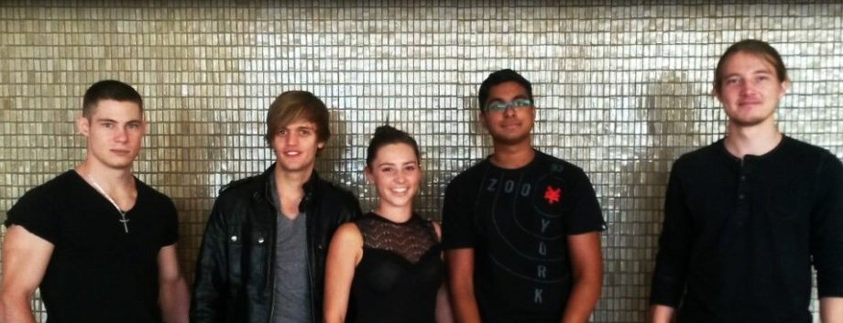
Team Eclectic
Project Linphone-Waterfall

Slide 2

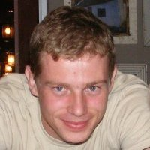
The Client
The Client 2.0
Kobus Coetzee

Slide 3

Work Division
David’s Slide

Slide 4
Work Division
Prenolan’s Slide

Slide 5
Work Division
Jessica’s Slide

Slide 6
Work Division
Izak’s Slide

Slide 7
Work Division
Pauls’s Slide

Slide 8

Thank You

